Slide 1
Software Design & Architecture Design Concepts
M Khizar Hayat
Khizer.hayat@ucp.edu.pk
Office: Building D 2nd floor
OFFICE HOURS: Tuesday : 02:00 PM- 04:00 PM
Friday: 11:00 AM- 01:00 PM

Slide 2
Today’s Agenda (Design Concepts)
Abstraction
Refinement
Modularity
Control Hierarchy
Software Architecture
Data Structure
Software Procedure
Information Hiding
Structural Partitioning
Functional Independence

Slide 3
Abstraction
Wasserman: “Abstraction permits one to concentrate on a problem at some level of abstraction without regard to low level detail.
At the highest level of abstraction a solution is stated in broad terms using the language of the problem environment.
Abstraction is used to hide background details or unnecessary implementation about the data. Users see only required information.

Slide 4
Types of abstraction
1. Procedural Abstraction :
A named sequence of instructions that has a specific & limited function
Example: Word OPEN for a door
2. Data Abstraction :
A named collection of data that describes a data object.
Data abstraction for door would be a set of attributes that describes the door
Example: (door type, swing direction, weight, dimension)

Slide 5
Refinement
Process of elaboration.
Start with the statement of function defined at the abstract level, decompose the statement of function in a stepwise fashion until programming language statements are reached.

Slide 6
Modularity
In this concept, software is divided into separately named and addressable components called modules
Follows “divide and conquer” concept, a complex problem is broken down into several manageable pieces
Let p1 and p2 be two problems.
Let E1 and E2 be the effort required to solve them ----->
If C(p1)>C(p2)
Hence E(p1)>E(p2)
Now------>
Complexity of a problem that combines p1 and p2 is greater than complexity when each problem is consider
C(p1+p2) > C(p1)+C(p2),
Hence E(p1+p2) > E(p1)+E(p2)
It is easier to solve a complex problem when you break it into manageable pieces

Slide 7
Modularity and Software Cost

Slide 8
Evaluation of Design Method w.r.t Modularity
Modular understandability
module should be understandable as a standalone unit (no need to refer to other modules)
Modular continuity
If small changes to the system requirements result in changes to individual modules, rather than system wide changes, the impact of side effects will be minimized
Modular protection
If an error occurs within a module then those errors are localized and not spread to other modules.
Modular Composability
Design method should enable reuse of existing components.
Modular Decomposability
Complexity of the overall problem can be reduced if the design method provides a systematic mechanism to decompose a problem into sub problems

Slide 9
Control Hierarchy
Also called program structure
Represent the organization of program components.
Does not represent procedural aspects of software such as decisions, repetitions etc.
Depth –No. of levels of control (distance between the top and bottom modules in program control structure)
Width- Span of control.
Fan-out -no. of modules that are directly controlled by another module
Fan-in - how many modules directly control a given module
Super ordinate -module that control another module
Subordinate - module controlled by another
Visibility -set of program components that may be called or used as data by a given component
Connectivity – A module that directly causes another module to begin execution is connected to it.

Slide 10
Control Hierarchy (Example)

Slide 11
Software Architecture
Software architecture is the hierarchical structure of program components (modules), the manner in which these components interact and the structure of data that are used by the components.
A set of properties should be specified as part of an architectural design:
Structural properties: This aspect of the architectural design representation defines the components of a system (e.g., modules, objects) and the manner in which those components are packaged and interact with one another.
Extra-functional properties: The architectural design description should address how the design architecture achieves requirements for performance, reliability, security, adaptability, and other system characteristics.
Families of related systems: The design should have the ability to reuse architectural building blocks.

Slide 12
Data Structures and Software Procedures
Data structures are ways to organize and store data so that it can be accessed and modified efficiently. Common types include:
Array, Link list, Stack, Queue, Tree, Graph, hash tables
Software procedures or algorithms are step-by-step instructions for performing tasks, like data manipulation or problem-solving, using data structures efficiently. Key algorithms include:
Searching Algorithm, Sorting Algorithm etc

Slide 13
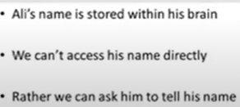
Information Hiding
Information (data and procedure) contained within a module should be inaccessible to other modules that have no need for such information.
Example:

Slide 14
Structural Partitioning
If the architectural style of a system is hierarchical program structure can be partitioned -----it can be
Horizontal partitioning
Vertical partitioning

Slide 15
Horizontal Partitioning
Process of elaboration.
Start with the statement of function defined at the abstract level, decompose the statement of function in a stepwise fashion until programming language statements are reached. Separate branches can be defined for each major function
Eg : 3 partitions
1. Input
2. Data Transformation
3. Output
Advantages
Easier to test
Easier to maintain
Propagation of fewer side effects
Easier to add new features

Slide 16
Example Horizontal Partitioning

Slide 17
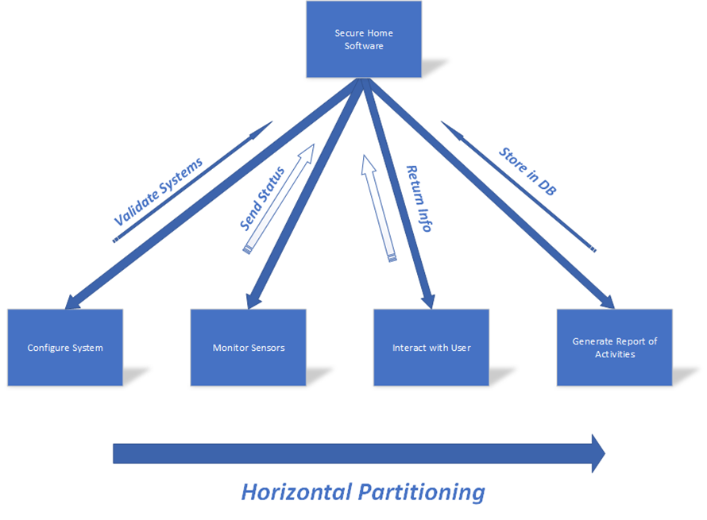
Example Horizontal Partitioning

Slide 18
Vertical Partitioning
Control and work modules are distributed top down
Top level modules perform control functions
Lower modules perform computations (input processing and output)

Slide 19
Example Vertical Partitioning

Slide 20
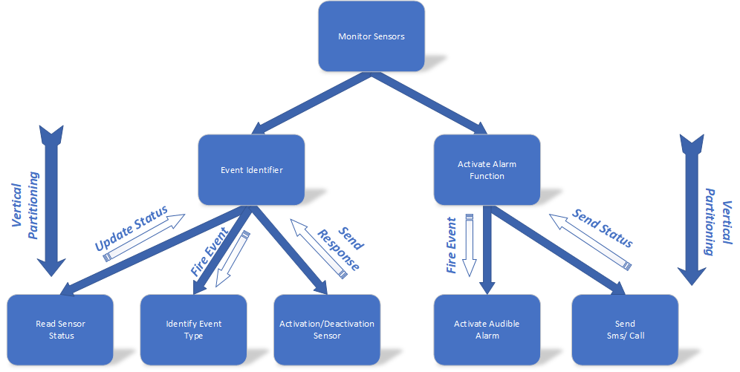
Example Vertical Partitioning

Slide 21
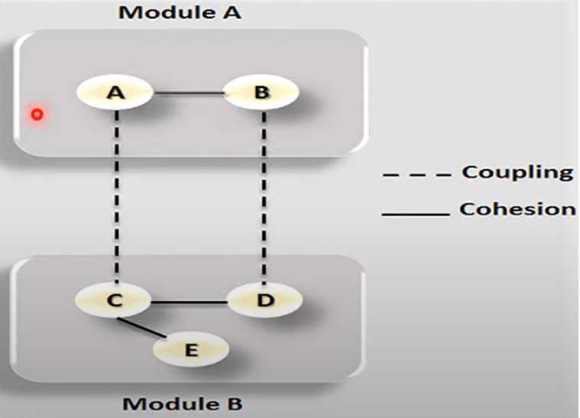
Functional Independence
Functional independence is achieved by developing modules with “single minded "function and an aversion to excessive interaction with other modules.
Measured using 2 qualitative criteria:
Cohesion : Measure of the relative strength of a module.
Coupling : Measure of the relative interdependence among modules.

Slide 22
Cohesion
Strength of relation of elements within a module
Element- Group of instructions or a data definition.
Strive for high cohesion
There are different types of cohesion
Functional (Highest)
Sequential
Communicational
Procedural
Temporal
Logical
Coincidental (Lowest)

Slide 23
Functional Cohesion
Functionally cohesive module contains elements that all contribute to the execution of one and only one problem-related task.
Examples of functionally cohesive modules are
Railway reservation system
Compute sale tax
Compute net salary

Slide 24
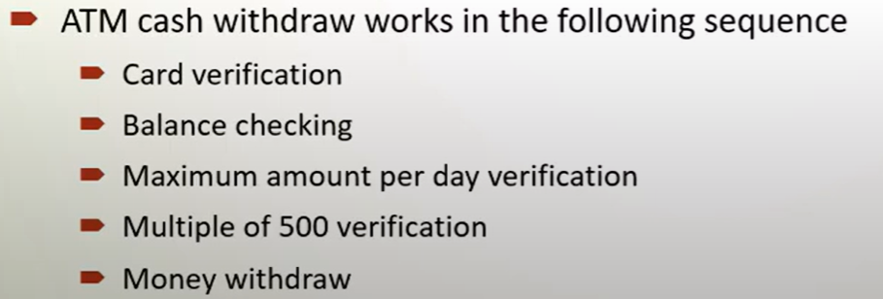
Sequential Cohesion
A sequentially cohesive module is one whose elements are involved in activities such that output data from one activity serves as input data to the next.
Eg: Module read and validate customer record
Read record
Validate customer record

Slide 25
Communicational Cohesion
A communicationally cohesive module is one whose elements contribute to activities that use the same input or output data.
Suppose we wish to find out some facts about a book. For instance, we may wish to
FIND TITLE OF BOOK
FIND PRICE OF BOOK
FIND PUBLISHER OF BOOK
FIND AUTHOR OF BOOK
These four activities are related because they all work on the same input data, the book, which makes the “module” communicationally cohesive.

Slide 26
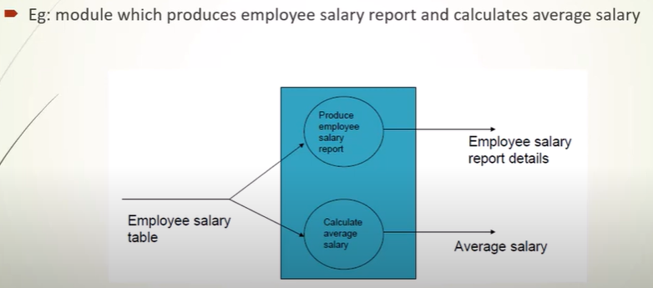
Communicational Cohesion

Slide 27
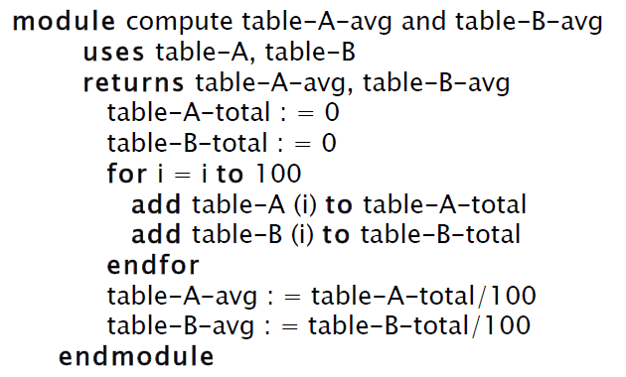
Procedural Cohesion
Eg: Module that averages two completely unrelated tables, TABLE-A and TABLE-B, which both just happen to have 100 elements each.

Slide 28
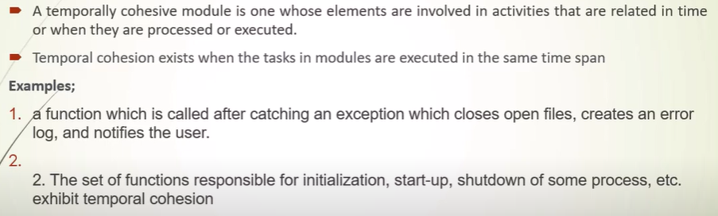
Temporal Cohesion

Slide 29
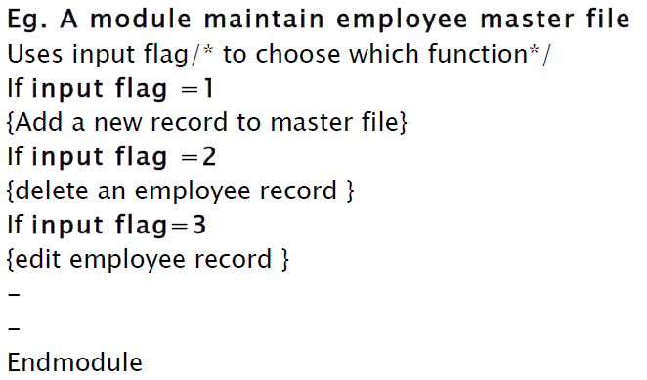
Logical Cohesion

Slide 30

Coincidental Cohesion (Lowest)
A coincidentally cohesive module is one whose elements contribute to activities with no meaningful relationship to one another.

Slide 31
Decision Tree for Module Cohesion

Slide 32
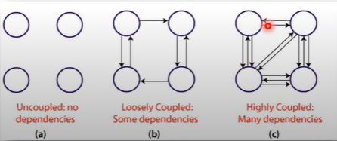
Coupling
Measure of interconnection among modules in a software structure
Strive for lowest coupling possible.

Slide 33
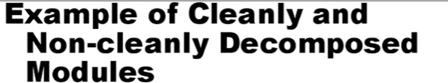
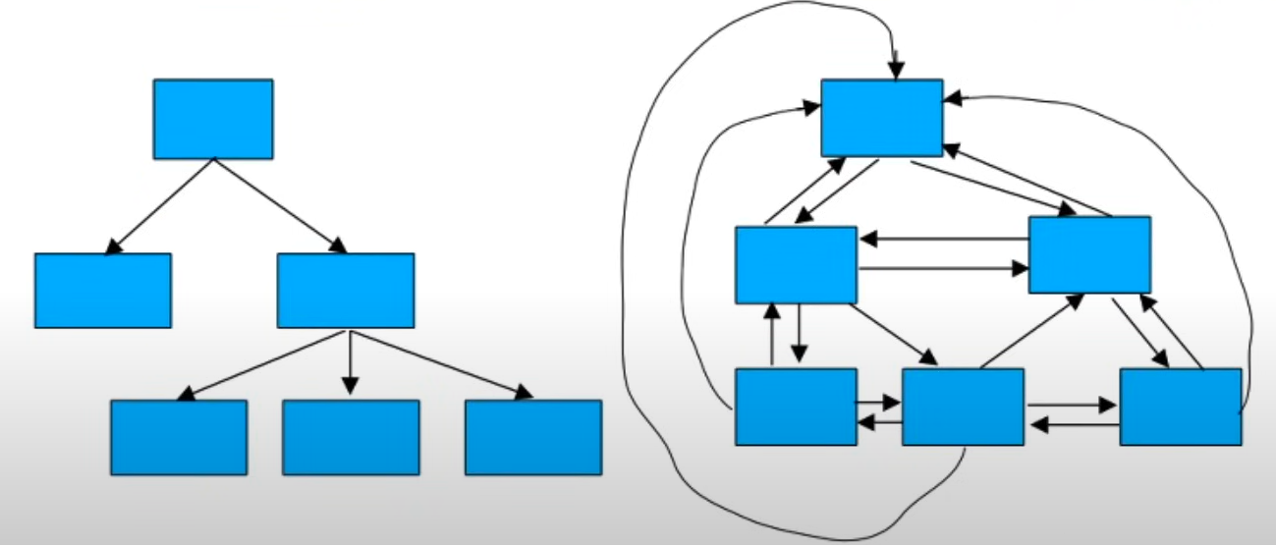

Slide 34
Coupling
Measure of interconnection among modules in a software structure
Strive for lowest coupling possible.
Types of coupling includes
Data Coupling (Best)
Stamp Coupling
Control Coupling
Common Coupling
Content Coupling (Worst)

Slide 35
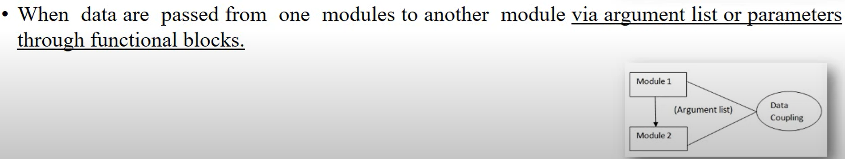
Data Coupling (Most Desirable)

Slide 36
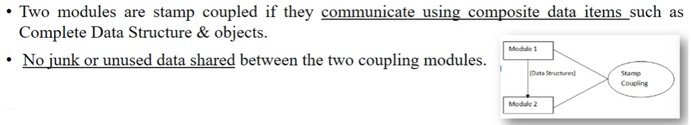
Stamp Coupling

Slide 37
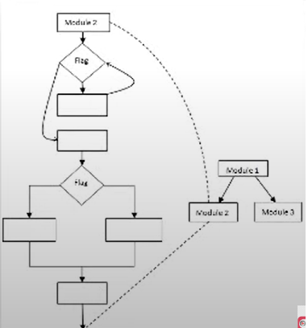
Control Coupling
Two modules are said to be control coupled if one module passes a control element to the other module.
This control element affects /controls the internal logic of the called module
Eg: flags

Slide 38
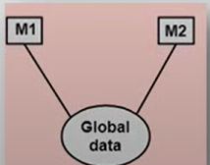
Common Coupling
Takes place when a number of modules access a data item in a global data area.
In the figure below, Modules M1 and M2 exhibit common coupling.

Slide 39
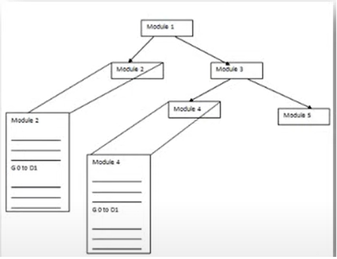
Content Coupling (Least Desirable)
Example:

Slide 40
Summary of types of coupling
Content Coupling: One module directly accesses the internal data or code of another
module.
Common Coupling: Two modules share global data.
Control Coupling: One module controls the flow of another by passing control information
(like flags or parameters).
Stamp Coupling: Modules share a data structure, but only parts of the data are used by
each module.
Data Coupling: Modules share only necessary data (e.g., passing simple arguments or parameters).
Message Coupling: Modules communicate only by sending messages to each other, with no data shared.

Slide 41
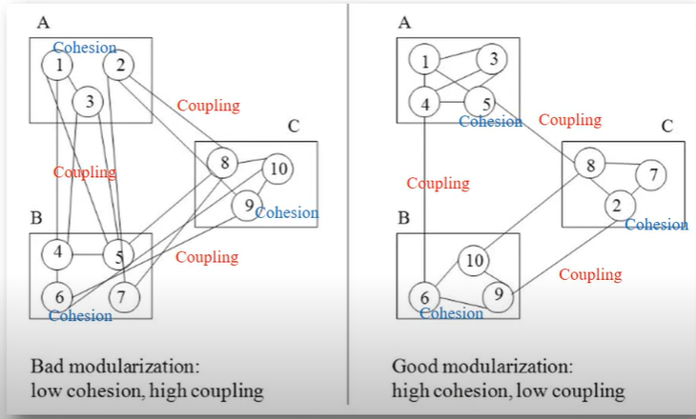
Good and Bad Software System Design

Slide 42
Design Heuristics for Effective Modularity
Evaluate 1st iteration to reduce coupling & improve cohesion
Minimize structures with high fan-out
Keep scope of effect of a module within scope of control of that module.
Evaluate interfaces to reduce complexity
Define modules with predictable function: A module is predictable when it can be treated as a black box.
Strive for controlled entry -- no jumps into the middle of things.

Slide 43
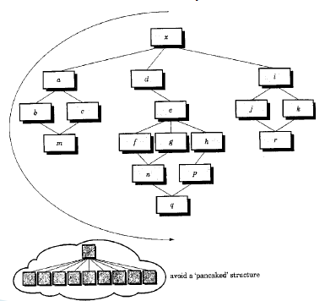
Design Heuristics for Effective Modularity

Slide 44
References
Selected Topics from CHAPTER 8 of the Book (Software Engineering. A practitioner’s Approach, by Roger .r . Pressman)
Selected Topics from CHAPTER 8 of the Book (Software Engineering. A practitioner’s Approach, by Roger .r . Pressman)
Topic Modularity from CHAPTER 6 of the Book (Software Engineering, Theory and Practice by Shari Lawrence Pleeger)

